Slide 1
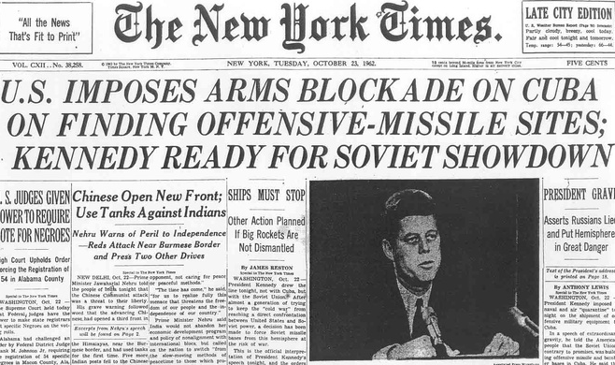
COLD WAR Flashpoint: CUBAN CRISIS
Background Info on the events leading to the Cuban Missile Crisis in October 1962

Slide 2
What was the Cold War?
The Cold War was a political struggle between the Western world, represented by the United States and NATO allies and the Eastern Bloc, organized by the Union of Soviet Socialist Republics (sometimes referred to as the Soviet Union or USSR) and its allies.
From roughly the end of World War II in 1945 until 1991, the U.S. and the Soviet Union competed against each other to demonstrate the superiority of each one’s politico-economic system: democracy and capitalism vs. authoritarianism and communism
During the Cold War, neither side directly engaged in all-out war with each other. However, they competed through proxy conflicts
whether political (supporting democratic or communist parties), economic (development aid)
military (supporting opposing forces in the “Third World”).
Initially, the superpowers focused on post-World War II Europe as they tried to win over states to their sides. As the Cold War progressed and dividing lines in Europe were consolidated, the superpowers increasingly focused on the developing world in South America, Asia, and Africa.

Slide 3
What is NATO? What was the Warsaw Pact?
The North Atlantic Treaty Organization, or NATO, is an alliance of countries formed initially from a core of Western European and North American states (the U.S., Canada, the UK, and others).
Founded in 1949, the alliance aimed to deter a Soviet invasion of Western Europe.
The alliance provided for collective defense, meaning that an attack against one member state was an attack against all members of the alliance.
NATO still exists and has added many ex-Communist countries in Europe as part of the alliance.
The Warsaw Pact was the Soviet version of NATO: it was an alliance of the Soviet Union and its Eastern European satellites.
The alliance was formed to deter a Western invasion of the member states that were part of the USSR’s sphere of influence.
It was founded in 1955, in part due to West Germany’s accession to NATO, and was sometimes referred to as the Eastern Bloc. The decline and fall of the Soviet Union led to the Warsaw Pact’s dissolution in 1991.

Slide 4
What was the Berlin Blockade of 1948?
During the negotiations ending World War II, the Allies agreed to split Germany into four parts:
three parts in the western half of the country, controlled by the Western allies (the U.S., France, and the United Kingdom);
and one part in the east controlled by the Soviet Union.
The Western allies established a democratic, capitalist government in their portion while the Soviets put in place a communist government in the territory they controlled.
The territories split into two new countries: democratic West Germany and communist East Germany.
The former capital city of Berlin, situated in East Germany had also been divided into Western and Eastern zones.
Due to the Western occupation of half of Berlin, an exclave of West Germany was surrounded by East Germany.
In 1948, the Soviet Union tried to force the Western powers out of Berlin by blockading all land routes to West Berlin until full control of the city was handed over to the Soviets. The Western powers overcame this by airlifting supplies to Berlin, until the Soviets ended the blockade in 1949.

Slide 5
What was the Berlin Crisis of 1958 to 1961?
In 1958, Soviet Premier Nikita Khrushchev issued an ultimatum to NATO demanding that it relinquish West Berlin to East Germany.
Khrushchev originally gave a six-month deadline, but this was continually pushed back until the crisis escalated in 1961.
During the summer of 1961, Khrushchev met Kennedy in Vienna and demanded yet again that NATO hand over control of West Berlin to East Germany.
Beginning on August 13, the Soviets and East Germans built a wall that bisected the city and prevented free passage between the Western and Eastern zones. Beginning on October 27, American and Soviet forces faced off at “Checkpoint Charlie,” an access point controlling passage across the wall.
The Berlin Crisis was eventually resolved when the United States acquiesced to the wall’s construction in November 1961.
Khrushchev had not yet achieved his objective of establishing East German control over West Berlin.
Khrushchev believed that the installation of Soviet missiles in Cuba could be used as leverage in negotiations over Berlin. Khrushchev thought that Washington might trade the removal of Soviet missiles from Cuba missiles for NATO’s retreat from West Berlin.

Slide 6
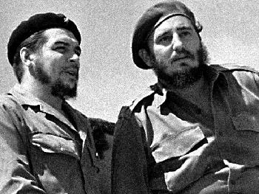
Who was Fidel Castro?
Revolutionary who in 1959 overthrew the government of Cuba
an island state 90 miles away from the U.S.
Became its new leader.
Castro first began his revolutionary struggle in 1953
After an initial defeat, he regrouped and launched a successful insurgency that caused President Fulgencio Batista to flee and allowed Castro to seize power.

Slide 7
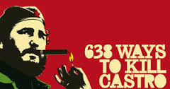
Why was Castro’s Cuba hostile to the U.S.?
The Cuban government was initially neutral to the superpower competition.
The Soviet Union initially was at first uninterested in Cuba, and Castro even toured the U.S. in 1959.
Yet Castro frayed the relationship with America when he threatened, and ultimately undertook, reforms that would harm American-owned property in the country.
The increasingly hostile relationship with the U.S. provided an opening for the Soviet Union.
Castro formed trade ties with Moscow and as Cuba grew closer to the USSR, relations with Washington deteriorated further.
The U.S. revoked its diplomatic recognition of Cuba at the beginning of 1961.

Slide 8
When and Why did the Soviet Union put missiles in Cuba?
The Soviet Union put missiles in Cuba for two primary reasons:
(1) to boost the Soviet Union’s power, threatening the U.S. with nuclear attack from the Caribbean and
(2) to bolster the Soviet Union’s bargaining position in its attempts to force West Berlin to join East Germany. Additional reasons included defending Cuba from American invasion and bolstering Soviet prestige.

Slide 9
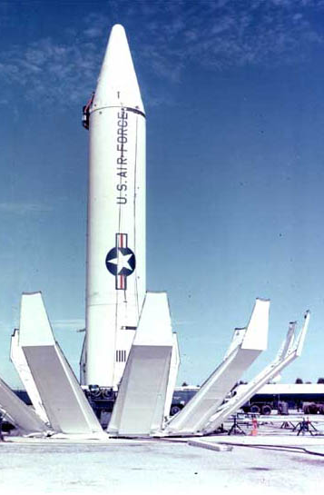
When and Why did the U.S. place missiles in Turkey?
The U.S. had prepared for a possible war in Europe by placing nuclear weapons in allied countries.
Bombers and ballistic missiles capable of delivering nuclear weapons were intended as a deterrent against a Soviet invasion of Germany and other NATO countries.
Nuclear missiles were placed in Turkey, a NATO member that shared a border with two Soviet republics, because of its proximity to the Soviet Union.

Slide 10
What were the Soviet forces in Cuba?
The Soviets installed 36 to 42 medium SS-4 medium-range ballistic missiles (MRBMs) in Cuba
Twelve short-range, Luna tactical nuclear missiles were also in Cuba.
The Soviets also had 80 Sopka-variant cruise missiles in four missile batteries arrayed along the Cuban coast. Many, if not all, of the warheads for these missiles were delivered to Cuba by the beginning of the Missile Crisis on October 14, 1962. Each missile’s warhead had an explosive capacity of 12 kilotons (three-quarters of the yield of the bomb dropped on Hiroshima).
There were also 42 unassembled IL-28 bombers
he Soviets had over 40,000 troops in Cuba.

Slide 11
Were the missiles in Cuba capable of nuking American cities?
45 warheads suitable for use on the 36 MRBMs arrived on October 4, 1962.
Had the Americans discovered the missile sites two weeks later, the MRBMs would have been armed and ready for launch against the United States.
Had the IL-28s successfully penetrated America’s air defenses in the southeast, they could have hit American cities.
If the U.S. had invaded Cuba, the local commander had been authorized to use tactical nuclear weapons in defense of the island. President Kennedy and his advisers were not aware of this. If tactical nuclear weapons had been used against U.S. forces, escalation to full nuclear war between the superpowers would have been very likely.

Slide 12
What did the United States know about the Cuban missiles at the time of the crisis?
The Americans identified 40 missile launchers in Cuba: these were the apparatuses necessary to launch a missile. There were 24 MRBM launchers and 16 IRBMs launchers.
At the time, according to Robert McNamara, the Americans did not believe there were nuclear warheads in Cuba. They also only estimated that there were 10,000 Soviet soldiers in Cuba, not the 40,000 that were actually there.

Slide 13
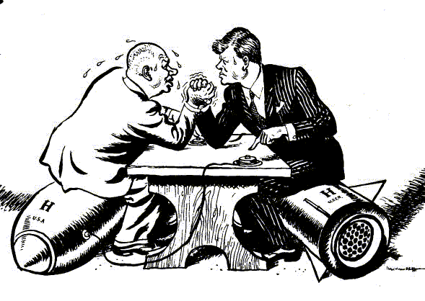
Who were the American and Soviet leaders during the Cuban Missile Crisis?
John F. Kennedy was President of the United States, having been elected in 1960.
Nikita Khrushchev assumed control of the Soviet Union in 1953 following the death of the previous leader Joseph Stalin.

Slide 14
What was EXCOMM?
The Executive Committee of the National Security Council, or EXCOMM was:
A group of American officials within the White House who were consulted during the Cuban Missile Crisis.
EXCOMM served as an advisory council to Kennedy during the Crisis.
Wide Range of official and unofficial advisors. Some Military, Some Civilian

