Slide 1
Eisenhower's “Military-Industrial Complex” Speech
Eisenhower, Jan. 17th, 1961

Slide 2
“I hate war.” - Eisenhower
Widely respected combat veteran
Served in WWI and WWII
Reputation for caring about his men
Believed the goal of humankind should be to make a soldier’s job obsolete
Promised to go to Korea during the 1952 Presidential Campaign to assist in ending the war.
July 27th, 1953, six months into his term, the UN and North Korea signed an armistice ending the war.
Ike vowed the United States wouldn’t get involved in any land wars with him as President.

Slide 3
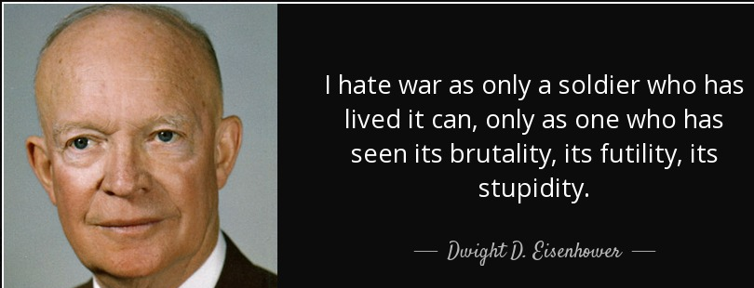
“Every gun that is made, every warship launched, every rocket fired signifies, in the final sense, a theft from those who are not fed, those who are cold and not clothed.” – Eisenhower

Slide 4
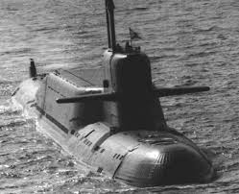
Eisenhower’s Plan
“The New Look”
Nuclear weapons would be the centerpiece of a new defense strategy.
Reduce the size of the conventional military
Cut the Federal Budget
Still funded many non-military programs
Ignored the cry of Weapons Manufactures that America needed new and better weapons for safety
Brinkmanship?

Slide 5
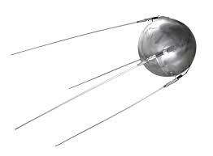
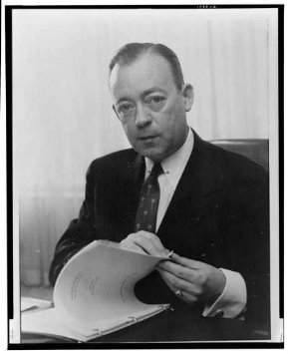
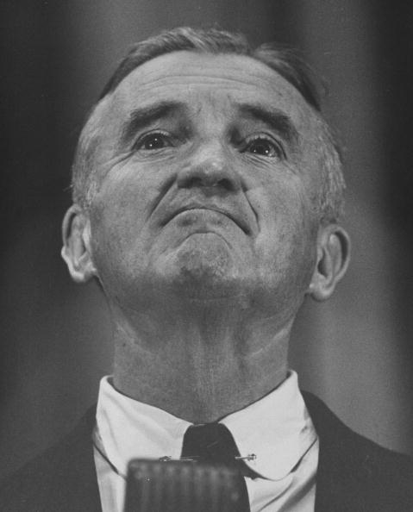
Arms Race and Space Race
Accusations that the “New Look” was allowing the Soviet Union to take the lead in high-tech weaponry
Soviets’ detonate a Hydrogen Bomb--August of 1953
Sputnik –First artificial satellite in outer space--Oct. 1957
Gaither Committee report Nov. 1957
Push for greater defense spending
Fallout Shelters
Penny Pinching put us in danger!
Political self-interest – Stuart Symington
“Missile gap” – Kennedy
U-2 Spy Plane program (Ike can’t Answer Critics)

Slide 6
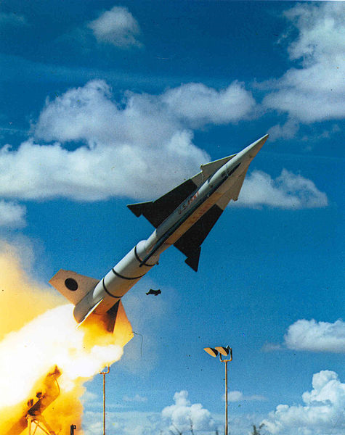
Rising Tension leads to Rising demand for Weapon Tech
Congressional Report on Defense contractors
1400 retired officers above the rank of Major
261 Generals and Admirals
Permanent war-based industry
“The problem of militarism…Flag and general officers retiring at early age take positions in the war-based industrial complex, shaping its decisions and guiding the direction of its tremendous thrust….This creates a danger that what the Communists have always said about us may become true …The merchants of death cannot come to dictate national policy…”

Slide 7
Eisenhower’s Farewell Speech - January 17th, 1961
“Until the latest of our world conflicts, the United States had no armaments industry. American makers of plowshares could, with time and as required, make swords as well. But now we can no longer risk emergency improvisation of national defense; we have been compelled to create a permanent armaments industry of vast proportions. Added to this, three and a half million men and women are directly engaged in the defense establishment. We annually spend on military security more than the net income of all United States corporations.
This conjunction of an immense military establishment and a large arms industry is new in the American experience. The total influence -- economic, political, even spiritual -- is felt in every city, every State house, every office of the Federal government. We recognize the imperative need for this development. Yet we must not fail to comprehend its grave implications. Our toil, resources and livelihood are all involved; so is the very structure of our society.
In the councils of government, we must guard against the acquisition of unwarranted influence, whether sought or unsought, by the military industrial complex. The potential for the disastrous rise of misplaced power exists and will persist.
We must never let the weight of this combination endanger our liberties or democratic processes. We should take nothing for granted. Only an alert and knowledgeable citizenry can compel the proper meshing of the huge industrial and military machinery of defense with our peaceful methods and goals, so that security and liberty may prosper together.”
https://www.youtube.com/watch?v=CWiIYW_fBfY
6:56-9:04

Slide 8
Military Industrial Complex
What is it?
Why is it scary?
The Military Industrial Complex describes the close relationship between the government and the permanent war-based defense industry.

Slide 9
Effects of the Speech
Vietnam 1964-1973
The speech resonated with Anti-war protesters
Seemed “prophetic”
1964—Ike quoted as saying:
“And the more bombs and bombers built, the more difficult it will be to disarm with honor, to negotiate away their demise.”
2003 Iraq War
Criticisms that Vice-President Dick Cheney is too “chummy” with his former employer, Halliburton.
https://www.youtube.com/watch?v=fIpjqiy2Sxs

