Slide 1
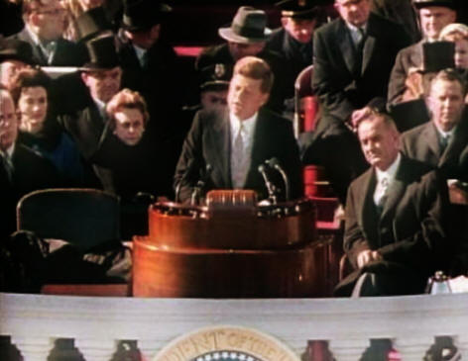
Election of 1960 and Kennedy’s Foreign Policy

Slide 2
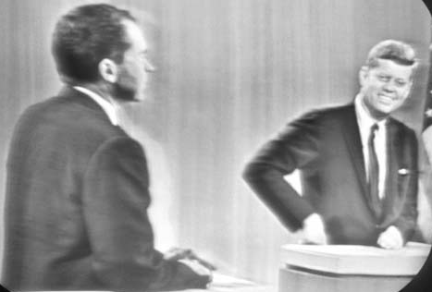
Election of 1960
Nixon vs. Kennedy
Economy in minor recession
Losing the Cold War?
Kennedy promised active leadership “to get America moving again.”
Nixon hoped Ike’s popularity would help him along with his experience
In reality both candidates had very similar views

Slide 3
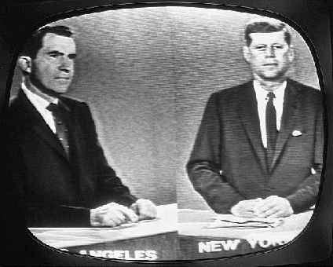
Cont. Election of 1960
Factors against Kennedy:
Would be second youngest president in the nations history, at 43.
Americans worried having a Roman Catholic in the white house
Nixon: expert on foreign policy
hope of exposing Kennedy’s inexperience
September 26, 1960 70 million TV viewers watched the first ever televised presidential debate
Kennedy: Coached by television producers; Spoke and Looked better than Nixon
The debate launched a new era in American Politics: The television age
Nixon Sweating
General info on Election

Slide 4
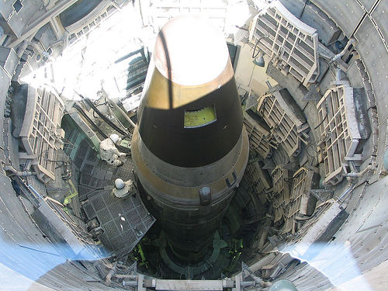
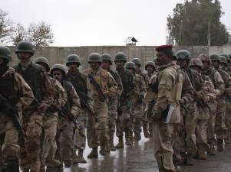
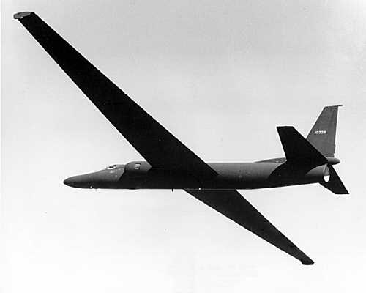
A New Military Policy
Won the election in part because he accused the Eisenhower administration of allowing a “Missile Gap” to develop between the US and the Soviet Union
Turns out there was one…..we had a huge lead in nuclear missiles
Kennedy and Secretary of Def. McNamara worked to redefine the nation’s nuclear strategy (Flexible Response)
Kennedy increased spending on defense to boost conventional military forces
He also tripled the overall nuclear capabilities of the U.S.

Slide 5
Crises Over Cuba
First Crisis: Castro’s Revolution
1956-1959 led a guerilla war to topple dictator Fulgencio Batista
Early on promised democracy
“Revolutionaries are not born they are made by poverty, inequality, and dictatorship.”
Anti-Imperialism or Straying towards Communism?
Seized three American and British Oil refineries
Broke up commercial farms (owned by American sugar companies) into communes to be worked by formerly landless peasants
Prior to the Revolution 75% of crop land owned by U.S. Companies
Congress creates a “Trade Embargo” against Cuba to force Castro from power

Slide 6
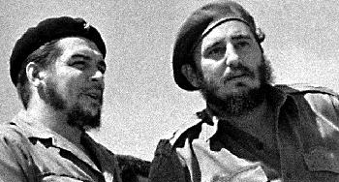
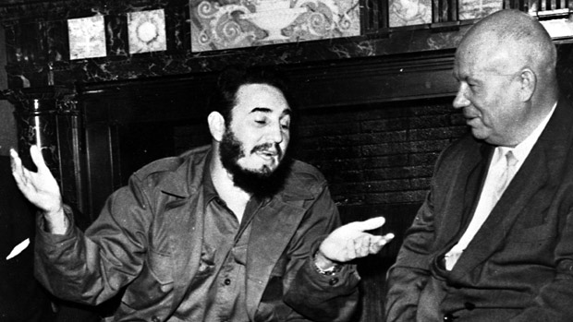
Effects of American Embargo
By 1960 it was clear that Castro was creating a communist dictatorship
Openly declares himself a communist in late 1960
Publically invites the Soviet Union to aid Cuba
Both Dangerous and Embarrassing to the United States
Soviet Union sends food and weapons
Castro represses all opposition
10% population flee for U.S.

Slide 7
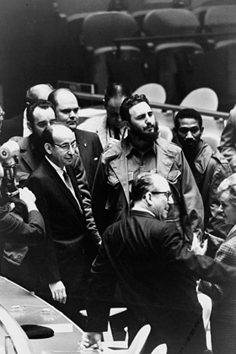
Bay of Pigs Invasion
CIA authorized by Eisenhower to train Cuban Refugees and send them back to Cuba to cause an uprising
Kennedy was skeptical, but allowed it.
Total failure….CIA made major mistakes in its intelligence.
Kennedy accepted the blame despite the fact that it wasn’t his fault…But he remembered the lesson..He makes the decisions from now on!

Slide 8
2nd Crisis: Nuclear Threat
Soviet Union continued to send weapons to Cuba through the summer of 1962
Publically, the Soviet Union promised the U.S. (through the United Nations and diplomatic talks) that they would not put “offensive weapons” in Cuba (Nuclear)
October 14th 1962: U-2 Spy Planes discover Soviet missile bases in Cuba
Some missiles already capable of launching
Most American Cities could be reached within 15 minutes or less
October 22nd: Kennedy informs the nation in a news conference that there are Nuclear Missiles in Cuba
He will attempt a diplomatic solution
prepared to invade Cuba with the full force of American military power

Slide 9
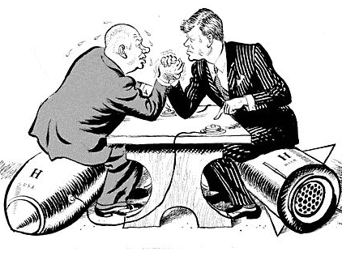
Cuban Missile Crisis
Warning: If missiles are launched from Cuba, the U.S. will launch a full scale attack on the Soviet Union
First real use of FLEXIBLE RESPONSE
Uses small amount of real force around Cuba by instituting a Naval blockade or “Quarantine” to prevent further missile delivery
It demonstrates JFK’s willingness to use force, but doesn’t use so much force that the Soviets feel compelled to respond with aggression

Slide 10
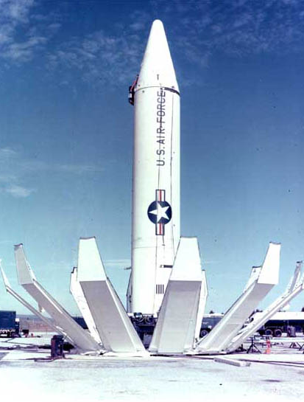
Ending the Crisis
Soviets turn back their inbound ships to Cuba
Secretary of State Dean Rusk: “We were eyeball to eyeball and the other fellow just blinked…”
Publically Khrushchev offered to remove the missiles in return for a “no invasion of Cuba” Pledge from JFK
Privately Khrushchev demanded that the U.S. dismantle missiles stationed in Turkey

Slide 11
Kennedy and Khrushchev take Heat
Khrushchev’s prestige in the Soviet Union and around the world was damaged
Kennedy also criticized by both sides
Accused of brinkmanship for not doing more diplomatic talking
Accused of passing up opportunity to invade Cuba and oust a communist dictator
Cuban exiles blame democrats for losing Cuba
Today a large number of Cubans especially in Florida are staunchly Republican
Republican Florida Senator: Marco Rubio. Born in 1971 to Cuban parents who immigrated to the US in 1956

Slide 12
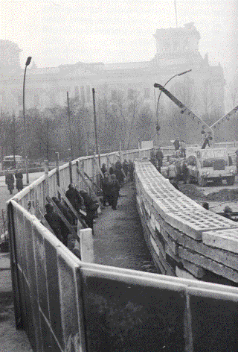
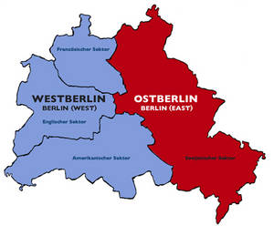
Crisis in Berlin
1961, 3 million East Germans had fled into West Berlin
Makes the Soviets and communism look bad
Brief period of tension in which everyone assumed the Soviets would invade west Berlin
Khrushev’s desire to save face but not start World War III led to the construction of the Berlin Wall.
The Berlin Wall ended the Berlin Crisis but further aggravated Cold War tensions

Slide 13
How to Ease Cold War Tension?
1963: A “Hot Line” was established between the White House and the Kremlin
Dedicated phone enabled the leaders of the two countries to communicate at once should another crisis arise
Solve the problem of trying to “read” into the actions of each country to determine if an Nuclear strike is imminent
Limited Test Ban Treaty
Barred Nuclear Testing in the atmosphere
While the Cold war is still in effect, the Nuclear threat has reduced

